Slide 1
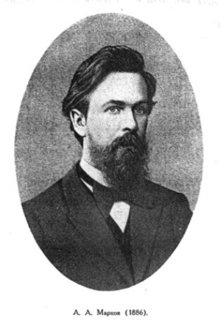
Markov Chain http://en.wikipedia.org/wiki/Markov_chain#Example
Adrey Markov
1856−1922
A Markov chain, named after Andrey Markov(1907), is a random process. (Its result is not determined previously)
We have a set of N states,
{S = s¹; s²; ...; s^{i}; ... s^{n} }
and the system may only be in one of them.

Slide 2
Markov Chain http://en.wikipedia.org/wiki/Markov_chain#Example
The process starts in one of these states and moves successively from one state to another.
{S = s¹; s²; ...; s^{i}; ... s^{n} }
Each move is called a step.

Slide 3
Markov Chain http://en.wikipedia.org/wiki/Markov_chain#Example
{S = s¹; s²; ...; s^{i}; ... s^{n} }
We can denote each of these states by a vector:
[1 0 0… 0...0] s¹
[0 1 0… 0...0] s²
[0 0 0… 1...0] s^{i}
[0 0 0… 0...1] s^{N}

Slide 4
Markov Chain http://en.wikipedia.org/wiki/Markov_chain#Example
{S = s¹; s²; ...; s^{i}; ... s^{n} }
s1 [1 0 0… 0...0]
s2 [0 1 0… 0...0]
….
si [0 0 0… 1...0]
….
sn [0 0 0… 0...1]
s^{t-2}
s^{t-1}
s^{t}
The future states depend only on the present state, and are independent of past states.

Slide 5
Markov Chain http://en.wikipedia.org/wiki/Markov_chain#Example
{S = s¹; s²; ...; s^{i}; ... s^{n} }
p_{t1}
s1 [1 0 0… 0...0]
s2 [0 1 0… 0...0]
….
si [0 0 0… 1...0]
….
sn [0 0 0… 0...1]
p_{t2}
s^{t-2}
s^{t-1}
s^{t}
p_{ti}
p_{tn}
However, for the same state s^{t}, we may have after the next step
different states, with different probabilities.

Slide 6
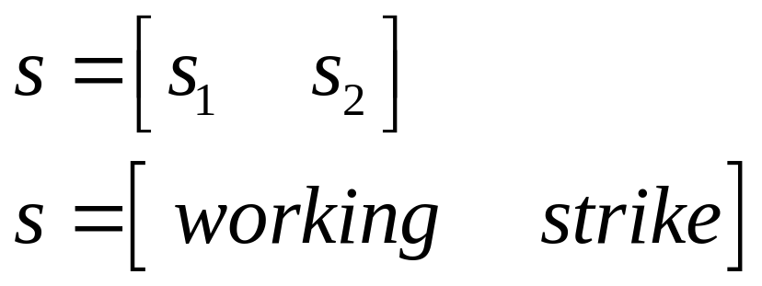
Markov Chain
Example
Let us imagine that we consider a factory in a conflictive country, where the operators must strike quite often because of their low salaries. Let us further denote the working status of the factory with a 0 or a 1 depending on the fact wether it is active or not, and let us define a status vector :

Slide 7
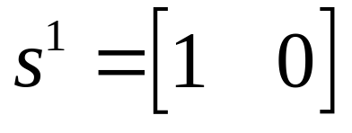
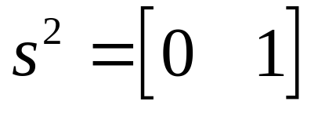


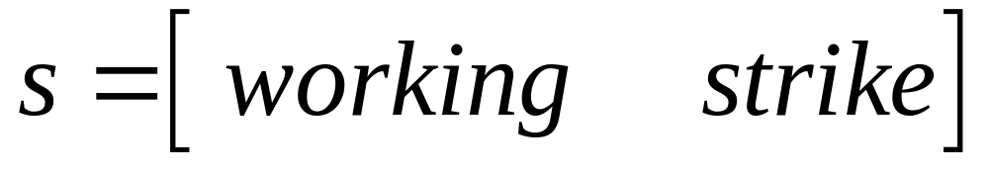
Markov Chain
Example
We have a set of 2 states.
{S = s¹; s²}

Slide 8
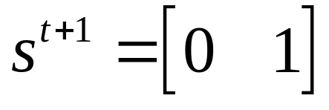


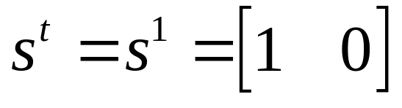
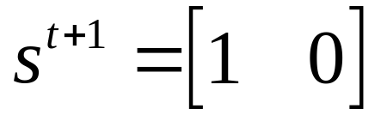
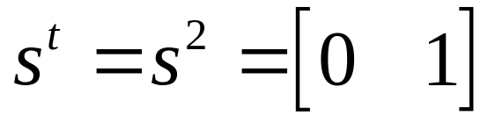
Markov Chain
Example
From a day to the next we may have two possibilities for each state

Slide 9
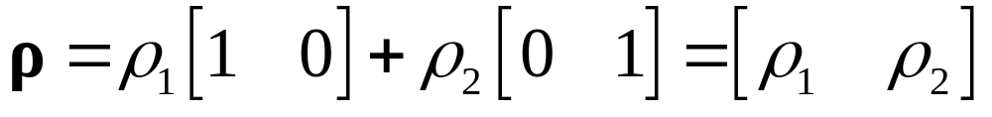
Markov Chain
Example
Let us consider the first case
ρ₂
ρ₁
If we perform many measurements, and we get a fraction of
times ρ₁ the state [1 0] and a fraction of times ρ₂ the state [1 0],
we can write a probability vector:

Slide 10


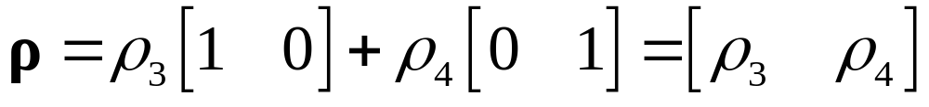
Markov Chain
Example
Let us consider the second case
ρ₄
ρ₃
If we perform many measurements, and we get a fraction of
times ρ₃ the state [1 0] and a fraction of times ρ₄ the state [1 0],
we can write a probability vector:

Slide 11
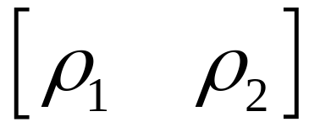
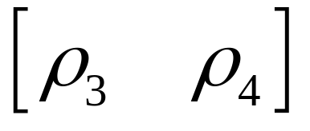
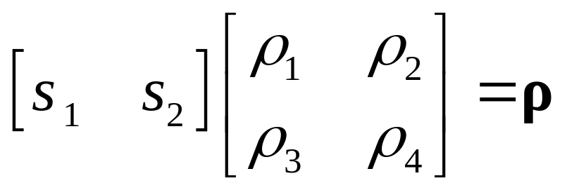
Markov Chain
Example
We can sintesize the results as
step.
step.
Or as a matrix product

Slide 12
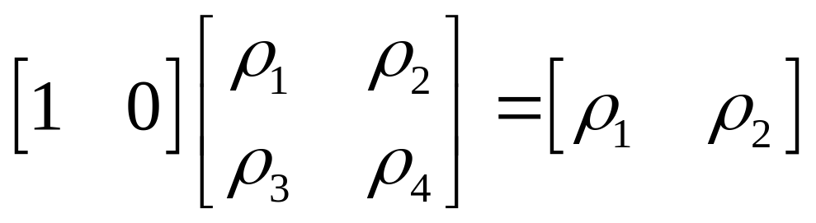
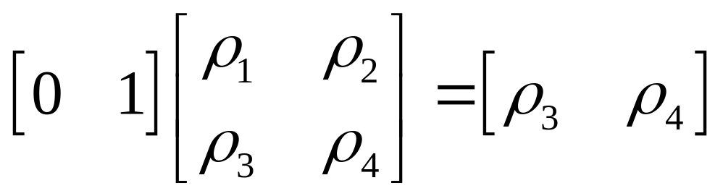
Markov Chain
Example
In fact:
and

Slide 13
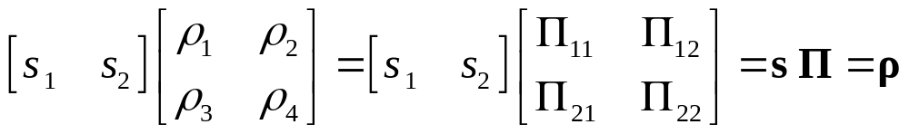

Markov Chain
Example
Matrix product
Is called TRANSITION MATRIX

Slide 14
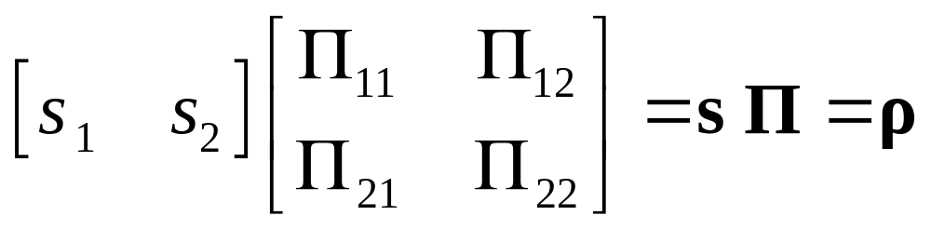
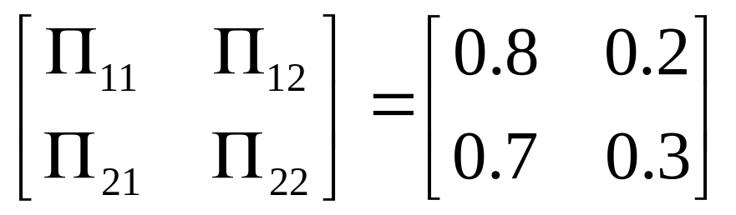
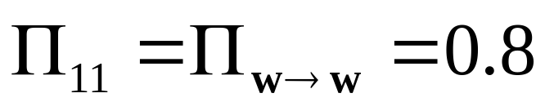
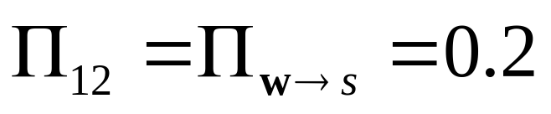
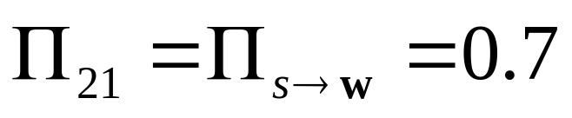
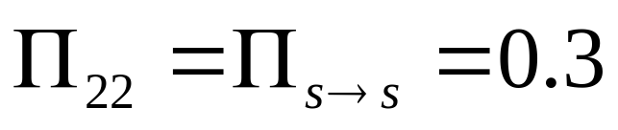
Markov Chain
Example
Let us make predictions for a given system:

Slide 15
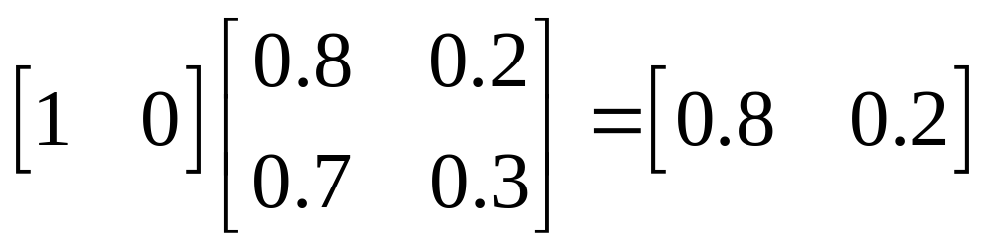
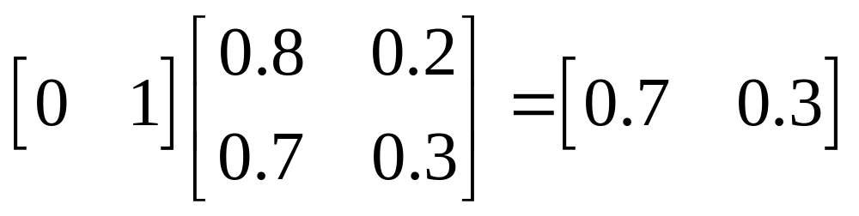
Markov Chain
Example
Let us make predictions for one day for the
two possible initial conditions
first day

Slide 16
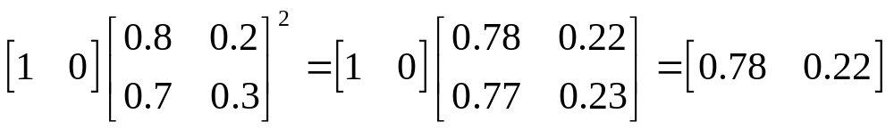
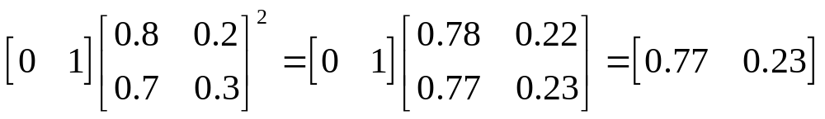
Markov Chain
Example
Let us make predictions for two days for the
two possible initial conditions
second day

Slide 17
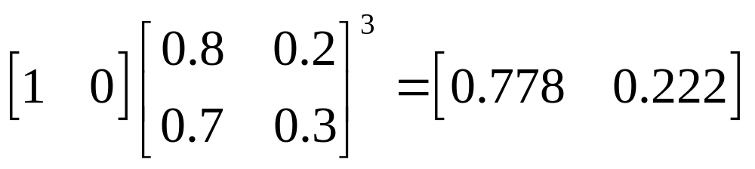
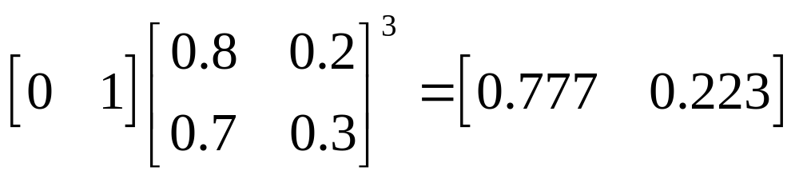
Markov Chain
Example
Let us make predictions for three days for the
two possible initial conditions
third day

Slide 18
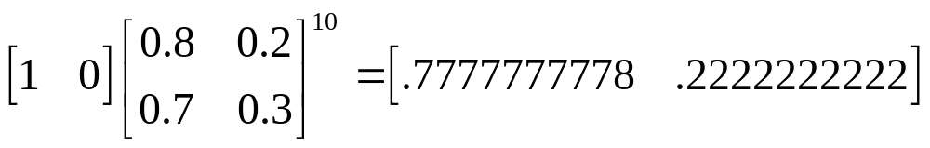
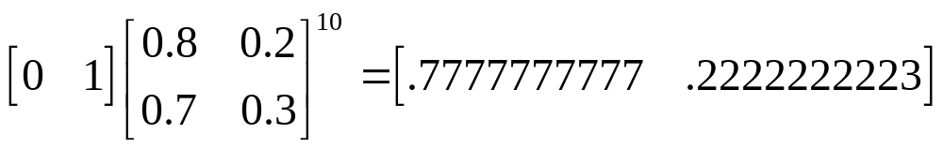
Markov Chain
Example
Let us make predictions for ten days for the
two possible initial conditions
tenth day
Long-range predictions are independent of the starting state.!!!
This is called a regular Markov chain

Slide 19
Markov Chain
Synthesis
The future states depend only on the present state, and are independent of past states.
The present state fully captures all the information that could influence the future evolution of the process.
Being a stochastic process means that all state transitions are probabilistic
Unpredictable in detail, though likely predictable in its statistical properties.

Slide 20
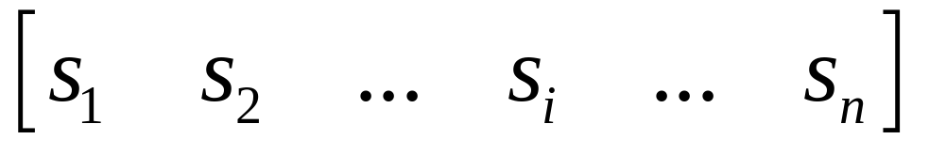
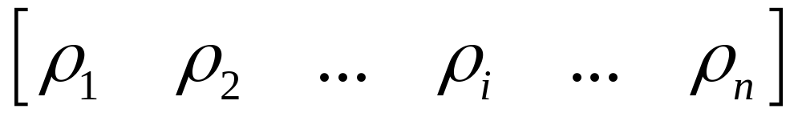
More on Markov Chains
Ergodic Markov Chains
A Markov chain is called an ergodic chain if it is possible to go from every state to every state (not necessarily in one move).

Slide 21
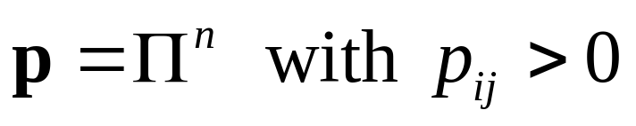
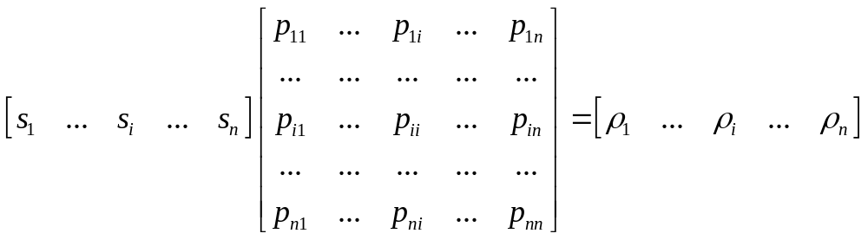
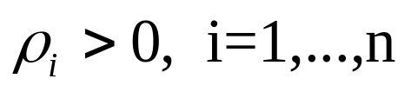
More on Markov Chains
Ergodic Markov Chains
A Markov chain is called a regular chain if some power of the transition matrix has only positive elements. Let us assume
p
s
ρ
Then for any unit vector s we will have
Then: every regular chain is ergodic.

Slide 22
More on Markov Chains
Ergodic Markov Chains
A row vector w with the property
wΠ = w
is called a fixed row vector for Π . Note that this defines a steady state.
Teor: For an ergodic Markov chain, w is unique and strictly positive (components are positive and add to 1).

Slide 23
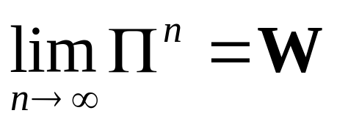
More on Markov Chains
Ergodic Markov Chains
Fundamental limit theorem for regular Markov chains:
if Π is a regular transition matrix then
Where W is a matrix with each row equal to the unique fixed probability row vector w for Π
Let us go to our previous example:

Slide 24
Markov Chain
Example
Let us make predictions for ten days for the
two possible initial conditions
tenth day
Long-range predictions are independent of the starting state.!!!
This is called a regular Markov chain

Slide 25
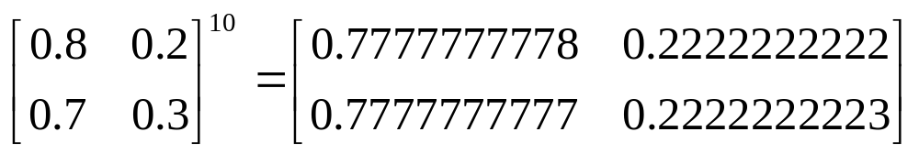
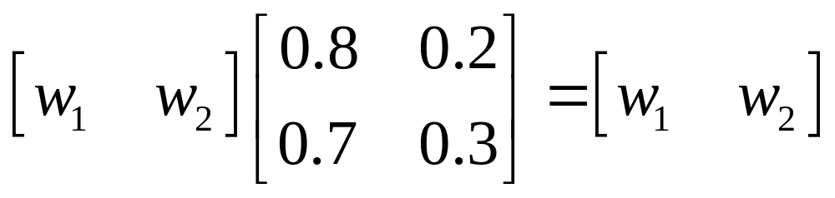


And calculate the 10th power of the matrix:
According to the previous theorem, we should get the row vectors from wΠ = w, or:
Which has the solution:

Slide 26
Markov Chain
Synthesis
The future states depend only on the present state, and are independent of past states.
The present state fully captures all the information that could influence the future evolution of the process.
Being a stochastic process means that all state transitions are probabilistic
Unpredictable in detail, though likely predictable in its statistical properties.

Slide 27
Can we simulate Markov Chains?
Let us devise a flow diagram for a program

Slide 28
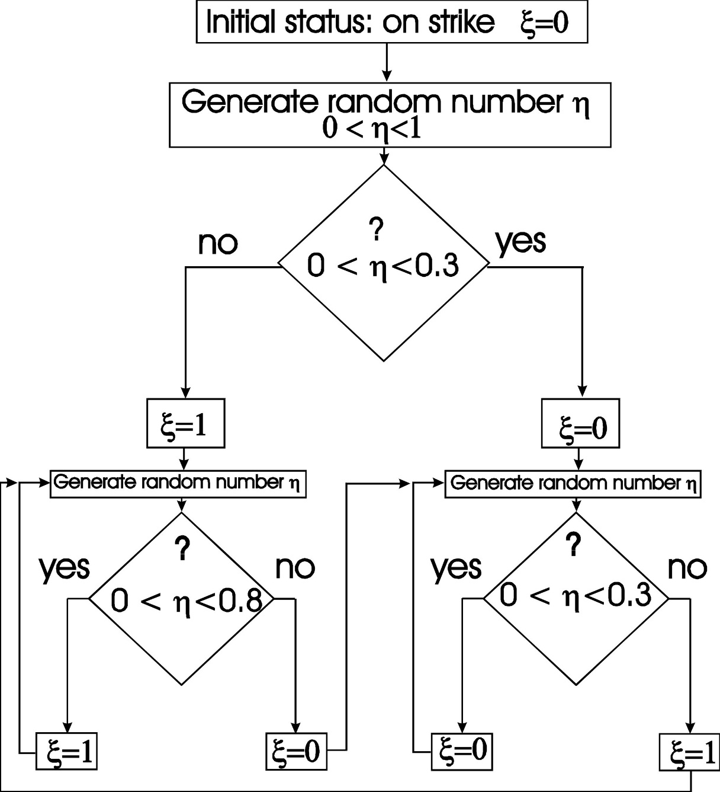

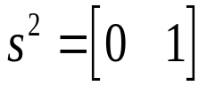
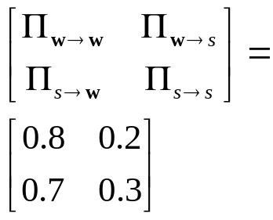
0.2
0.8
0.3
0.7

Slide 29
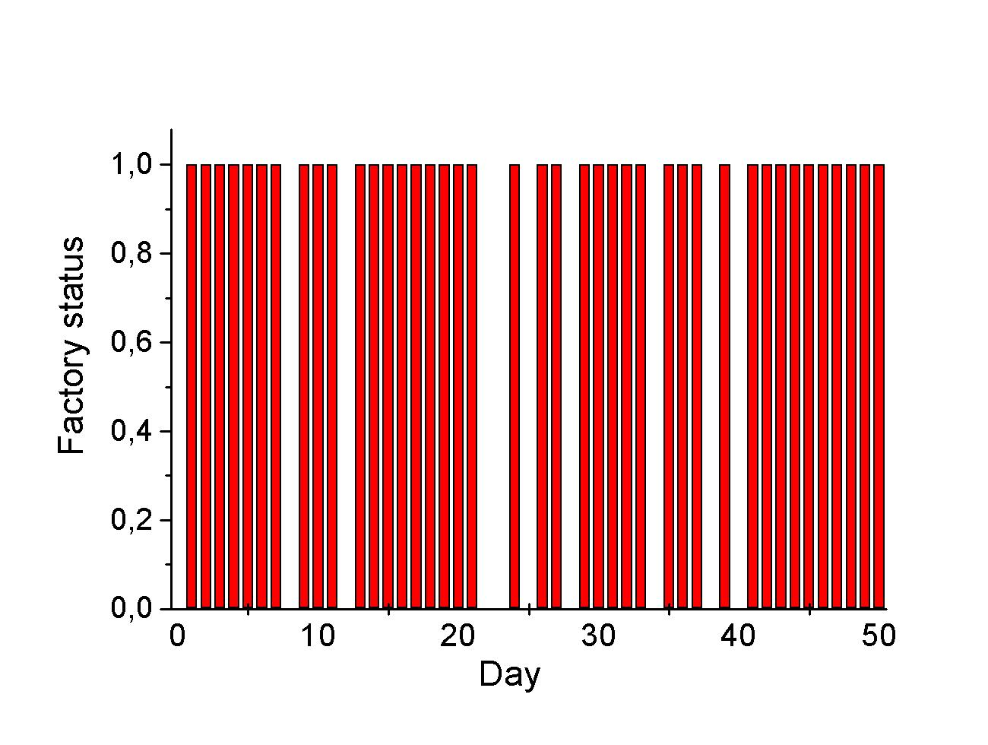
Sequence of values of the random variable ξ representing the status of a factory (ξ=1 factory working, ξ=0 factory not working, for the first 50 steps of the simulation

Slide 30
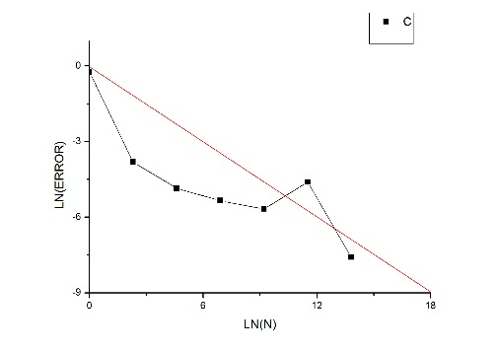
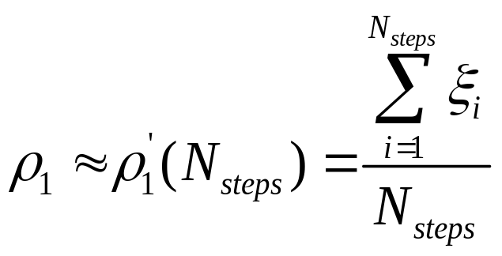


Probability of the factory working:
0 | 1
0.8 | 10
0.77 | 10²
0.773 | 10³
0.7812 | 10⁴
0.78777 | 10⁵
0.777273 | 10⁶

Slide 31
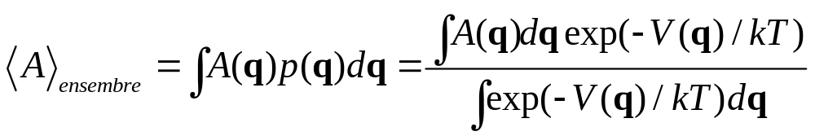
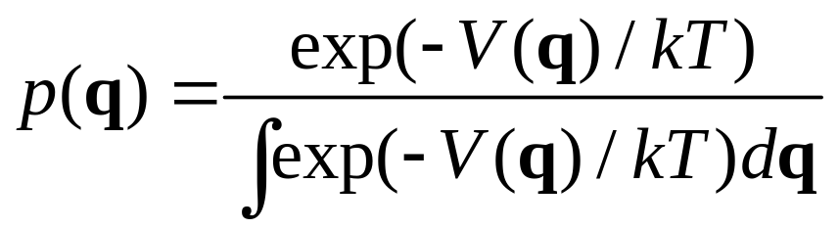
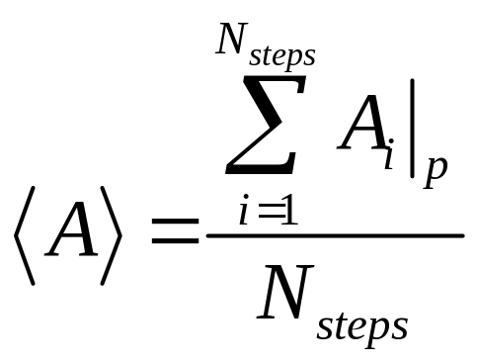
Going back to the calculation of averages
So, all we need is to generate configurations of the system with the probability density p(q) and calculate:

Slide 32
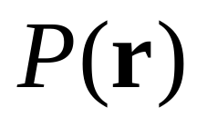
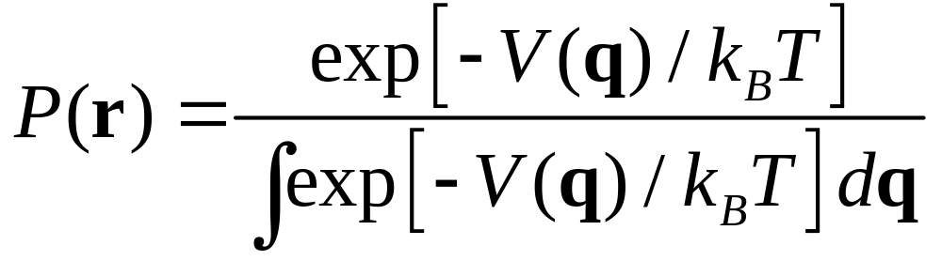
Problem: we don´t know
Let us think in term of a Markov chain.
First we have to define a state vector:
{S = s₁; s₂; ...; s_{i}; ... s_{n} }
To image what is component mean, let us tk

Slide 33

{S = s1; s2; ...; si; ... sn }
To imagine what each component mean, let us think in one particle in a (very finely) discretized configuration space:
Thus, each S component corresponds to a point of the (discretized) configuration space of the particles. For a n_{x} n_{y} n_{y} grid, the vector has a (n_{x} n_{y} n_{y} ) dimension.

Slide 34
{S = s1; s2; ...; si; ... sn }
To imagine what each component mean, let us think in two particles a (very finely) discretized configuration space:
Thus, each S component corresponds to a point of the (discretized) configuration space of the particles. For a n_{x} n_{y} n_{y} grid and M molecules, the vector has a (n_{x} n_{y} n_{y} )^{M} dimension.

Slide 35

So S is a very big vector, like
{S = (0; 0; ...; 1; ...; 0) }
Where the 1 points to the present configuration of the system. Analgously, ρ is a vector of the same dimension looking like:
ρ=(ρ₁; ρ₂; ...; ρ_{ι}; ...; ρ _{(nx ny ny )}^{M} )
containing the probabilities of each state.

Slide 36




Let us now consider the steady state condition:
Or the same equation in terms of the components
This is a system of equations where the ρ_{j} is one of the ρ_{j} in the sum. We can now show that if we impose the condition(detailed balance) :
the steady state condition will be satisfied.

Slide 37

So all we need now is a choice for the transition matrix elements Π_{ij.}.

Slide 38
NOW LET US GO TO AN EXAMPLE
…………………………………………

Slide 39


The particle was moving in a potential V(q)
We may think as a particle in equilibrium with a reservoir at temperatura T
In principle, we could calculate the configuration integral function as:
An the probability of finding the particle at a certain position q as:

Slide 40

In the example we chose
Let us check if this satisfies:

Slide 41



The case U_{j} = U_{i} is trivial. Let us see U_{j} > U_{i}
In the last equation we used the probability density in the canonical ensamble (Note that the configuration integral dissapears!)

Slide 42


The other case U_{j} < U_{i}

Slide 43
REMARKS:
Why do we find the minimum?

Slide 44

REMARKS:
Why do we find the minimum?

Slide 45
So we are ready for simulations!

